Slide 1
Pre-Calc & Trig
Day 3

Slide 2
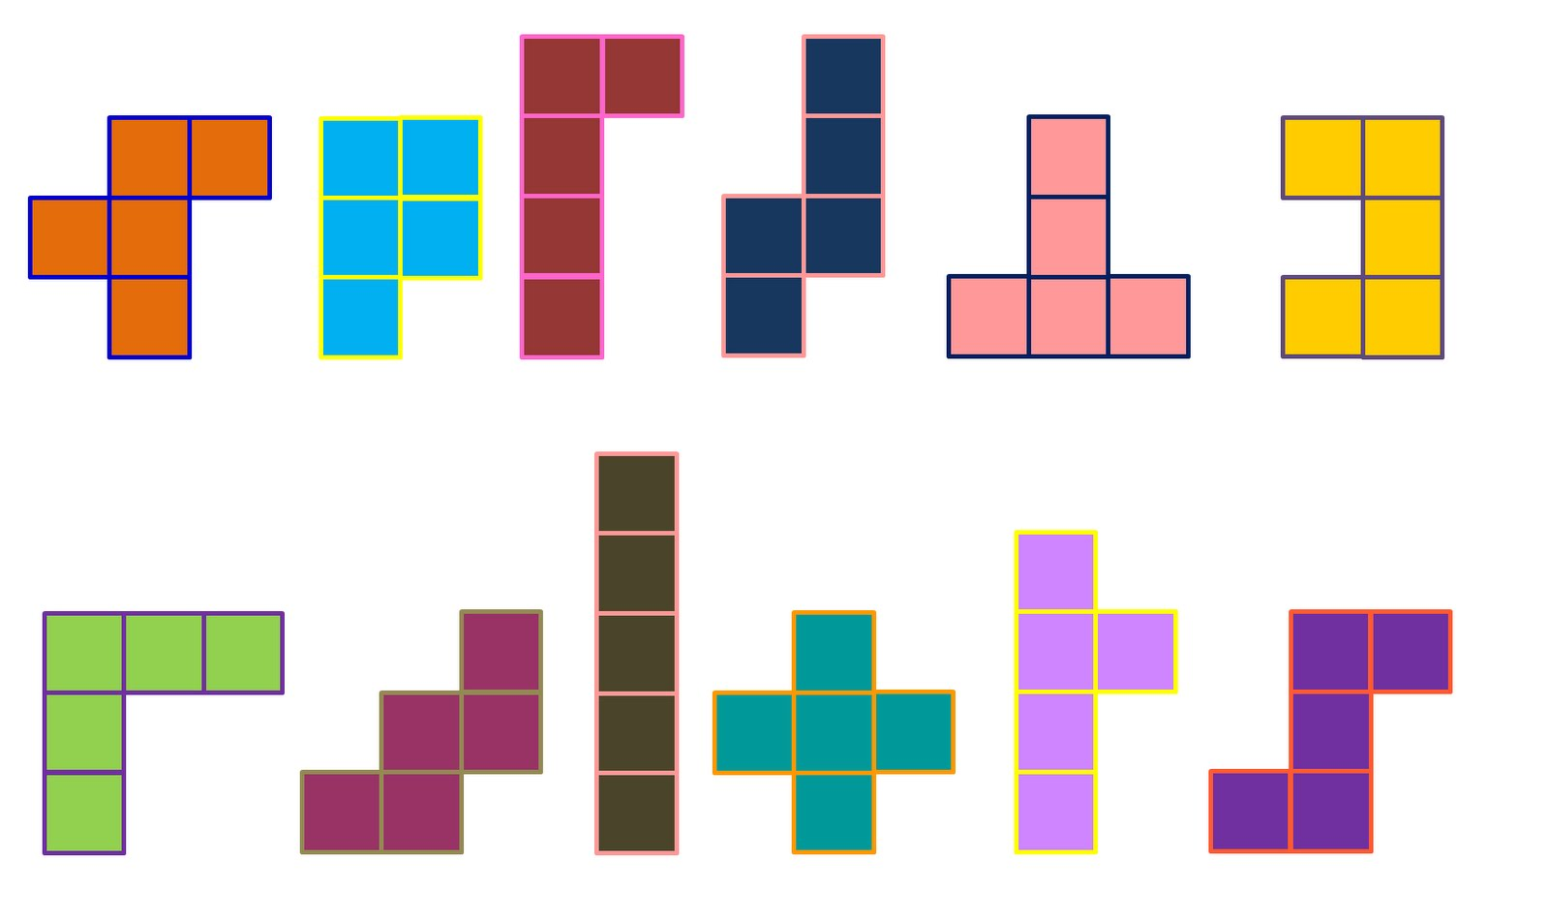
Bell Work
What the heck is a Pentomino?
Why do you think they are common in tiling floors and walls, or games like Tetris?
Where do you think it got its name, with a prefix like “Pento”?
Challenge:
Are there more Pentominoes than the ones
we worked with today? If yes, draw them. If no,
explain why there are no more.

Slide 3
Objective
Use a project with Pentominoes to continue our understanding of patterns, by incorporating plotting points.

Slide 4
Finish Project Where We Left Off…

Slide 5
Pentominoes (you will be selecting 2-3 of these to make your pattern)

Slide 6
Okay… Go! Get Started with Phase 1 (15+ minutes)
Select 2 or 3 of the Pentominoes on the following slide.
Create a tiled pattern on your graph paper… using the 2 or 3 Pentominoes that you select (alternate colors where you feel it is appropriate to help understand the pattern you are creating).
You will be coloring in the squares on the graph paper to make the shapes
Only fill in ½ of your graph paper with your pattern and then stop.

Slide 7
Project Directions (Phase 2) (20ish+ minutes)
Get in groups of 2-3 people
Switch your papers so that you no longer have your own pattern
Take 3 minutes to quietly look at the pattern (do not write anything)
Take turns discussing in your groups (1-2 minutes each) on what you think the pattern is, and clarify with the originator if there are questions
Now continue to draw the pattern on your ‘new’ Pentominoes tile (in other words I will be finishing someone else’s pattern)

Slide 8
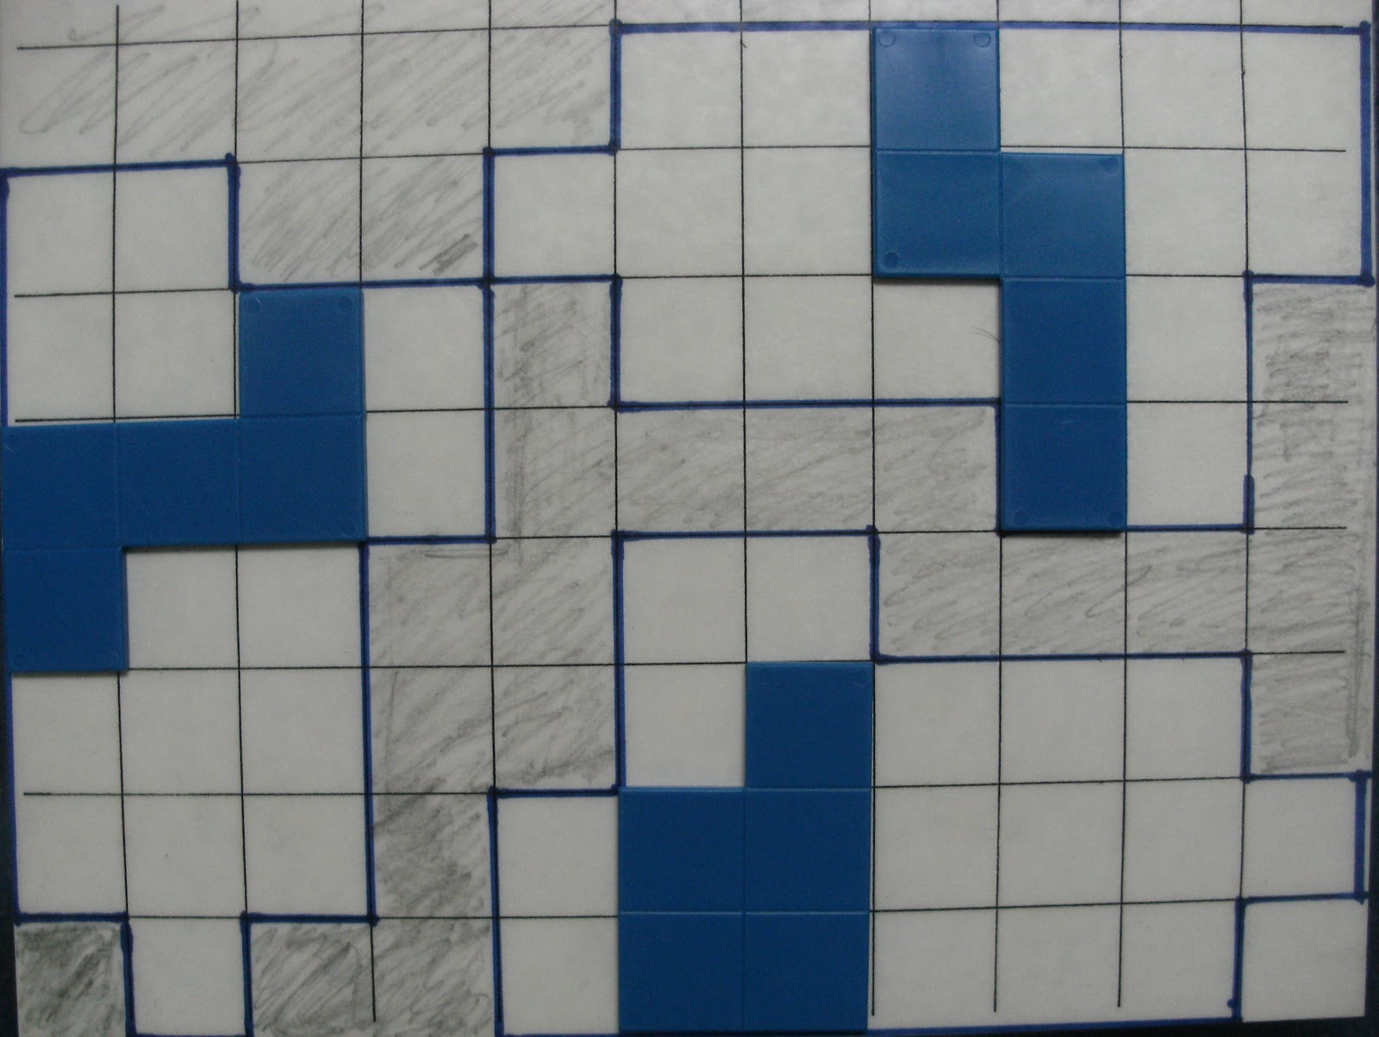
Project Directions (Phase 3) (10-15 minutes)
Identify 2 Pentominoes in each quadrant (what the heck is a quadrant?!) and outline, highlight, or identify in some way that those are the 2 you are talking about in each quadrant.
Example: The solid blue (at right) are clearly identified as the 3 you are talking about (do this in each quadrant).
■ On a separate piece of paper (or around the outside of the grid, write the all of the coordinates of the 8 individual Pentominoes.
■ Return the paper to the originator, and have them check that the coordinates in fact do correspond to the correct Pentominoes

Slide 9
Project Directions (Phase 4) (10-20 minutes)
Have one group member share one of the projects from the group. (It doesn’t have to be their own that they share).
Things to Discuss:
Most challenging piece
What went into making the pattern complete
If time permits, have the presenter read off the coordinates for 2 of their Pentominoes, and have the other groups graph their location

Slide 10
Project Directions (Phase 5)
In a few sentences please answer the following.
What did you find easiest about this project?
What did you find most challenging about this project?
If you could change one thing about this project, what would it be AND why?
Did you think it was easier to create your own pattern, or complete someone else’s pattern? What made your choice the easier choice?
Why do you believe we took on this project?

Slide 11
The Unit Circle
On a separate piece of paper…
Sketch the Unit Circle
Label as many of the key points as possible

Slide 12
